Slide 1
Railway Tracks in India: State wise Overview
Presented By:
N.VIJI - SOLMALAI COLLEGE OF ENGINEERING - CIVIL

Slide 2
OUTLINE
Introduction
Overview Map
State wise Breakdown - North India
State wise Breakdown - South India
State wise Breakdown - East India
State wise Breakdown - West India
Conclusion
References

Slide 3
INTRODUCTION
Mass Transport India has a massive population, and railways provide a cost-effective and efficient means of mass transportation.
Accessibility Railways connect even the remotest parts of the country, making them accessible to people and facilitating economic development
Economic Growth They are the backbone of freight transportation, carrying goods such as raw materials, agricultural produce, industrial products, and consumer goods across the country
Environmentally Compared to road transport, railways are more environmentally friendly
Employment It provides jobs not only in train operations but also in maintenance, construction, Generation signaling, ticketing, and other related services.

Slide 4
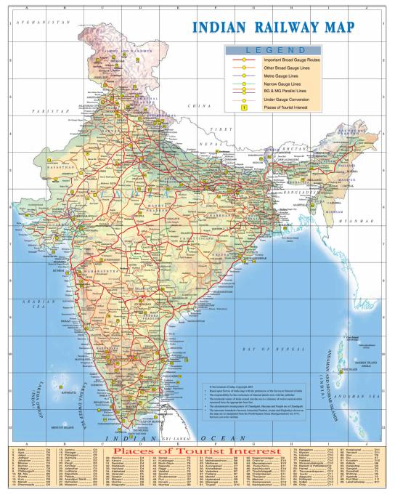
Overview Map

Slide 5
State wise Breakdown - South India
Uttar Pradesh Uttar Pradesh boasts one of the densest railway networks in India.
Total Length:16,001km
Rajasthan Rajasthan's railway network traverses through its diverse terrain, connecting major cities and tourist destinations, Total Length:9,190km
Punjab Punjab's railway infrastructure is vital for both passenger and freight transportation. Total Length:3,622km
Haryana Haryana's railway network plays a crucial role in connecting the state with neighboring regions.Total Length:3,243km
Uttarakhand Uttarakhand's scenic railway routes attract tourists and pilgrims alike.
Total Length:528km
Himachal Pradesh Himachal Pradesh's narrow gauge railways offer breathtaking views of the Himalayas Total Length:376km
Jammu and Kashmir Jammu and Kashmir's railway network includes the iconic Jammu- Udhampur-Srinagar-Baramulla line. Total Length:493km

Slide 6
State wise Breakdown - North India
Tamil Nadu Tamil Nadu boasts an extensive railway network connecting major cities, industrial centers, and tourist destinations, Total Length: 6,836 km
Karnataka Karnataka's railway network plays a crucial role in connecting the state's diverse regions and supporting its economy, Total Length: 6,083 km
Andhra Pradesh Andhra Pradesh's railway infrastructure is vital for both passenger and freight transportation, serving as a key link in South India,Total Length:7,714km
Telangana Telangana's railway network connects its major cities and industrial hubs, contributing to the state's economic growth, Total Length:3,223km
Kerala Kerala's picturesque railway routes are renowned for their scenic beauty and serve as important tourist attractions, Total Length:2087km
Puducherry Puducherry is connected to the mainland through railway lines, facilitating (Union Territory) transportation to and from the territory, Total Length:26km

Slide 7
State wise Breakdown - East India
West Bengal West Bengal's railway network is one of the busiest in India, serving as a vital transportation link for the state and the eastern region Total Length: 10,309km
Bihar Bihar's railway infrastructure is essential for both passenger and freight transportation, connecting the state's cities, towns, and rural areas Total Length: 7,663 km
Jharkhand Jharkhand's railway network supports the state's mining and industrial sectors, facilitating the transportation of mineals, goods, and passengers.Total Len gth: 6,296 km
Odisha Odisha's extensive railway lines connect its coastal areas, industrial zones, and cultural centers, contributing to the state's economic development Total Length: 5,506 km
Assam: Assam's railway network links it with the rest of India and plays a crucial role in the transportation of goods and passengers in the northeastern region
Total Length: 3,662 km
Tripura Tripura's railway connectivity enhances accessibility to the state and promotes economic development and tourism. Total Length: 337 km

Slide 8
State wise Breakdown - West India
Maharashtra Maharashtra's railway network is one of the busiest in India, serving major cities, industrial centers, and tourist destinations Total Length: 11,631 km
Gujarat Gujarat's railway infrastructure plays a vital role in facilitating trade and commerce, connecting ports, industrial zones, and urban center Total Length: 7,938 km
Goa Goa's picturesque railway routes offer scenic views and serve as an important mode of transportation for tourists and locals alike. Total Length: 111 km
Madhya Pradesh Madhya Pradesh's railway lines connect its urban centers, rural areas, and industrial regions, supporting the state's economy
Total Length: 9,702 km
Dadra and Nagar Haveli and Daman and Diu (Union Territories):
These union territories have railway connectivity to the mainland, enhancing accessibility and promoting development. Total Length: 191 km

Slide 9
Challenges and Future Prospects
Capacity Constraints - The Indian Railways faces challenges related to capacity constraints, especially on busy routes and during peak hours.
Infrastructure Modernization- Upgrading and modernizing existing railway infrastructure is a significant challenge
Funding and Financial Sustainability - Indian Railways requires substantial funding for infrastructure development, maintenance, and expansion projects.
Future Prospects
High-Speed Rail Projects- The implementation of high-speed rail projects such as the Mumbai-Ahmedabad High-Speed Rail (MAHSR) and other proposed corridors presents
Public-Private Partnerships (PPPs)- Encouraging private sector participation through PPPs can mobilize investment, promote innovation, and expedite infrastructure development.

Slide 10
Conclusion
Critical Infrastructure
Accessibility
Economic Growt
Traffic Decongestion
Energy Efficiency
Employment Generation

Slide 11
REFERENCE
https://www.kaggle.com/datasets/vickeytomer/statewise-railway-track-in-kilometers?select=NDAP_REPORT_7235.csv

Slide 12
THANKYOU

